Slide 1
HOUSING: PRICE PREDICTION

Slide 2
Features impact sale Price
Id, MSSubClass, MSZoning, LotFrontage, LotArea, Street, Alley, LotShape, LandContour, Utilities, LotConfig, LandSlope, Neighborhood, Condition1, Condition2, BldgType, HouseStyle, OverallQual, OverallCond, YearBuilt, YearRemodAdd, RoofStyle, RoofMatl, Exterior1st, Exterior2nd, MasVnrType, MasVnrArea, ExterQual, ExterCond, Foundation, BsmtQual, BsmtCond, BsmtExposure, BsmtFinType1, BsmtFinSF1, BsmtFinType2, BsmtFinSF2, BsmtUnfSF, TotalBsmtSF, Heating, HeatingQC, CentralAir, Electrical, 1stFlrSF, 2ndFlrSF, LowQualFinSF, GrLivArea, BsmtFullBath, BsmtHalfBath, FullBath, HalfBath, BedroomAbvGr, KitchenAbvGr, KitchenQual, TotRmsAbvGrd, Functional, Fireplaces, FireplaceQu, GarageType, GarageYrBlt, GarageFinish, GarageCars, GarageArea, GarageQual, GarageCond, PavedDrive, WoodDeckSF, OpenPorchSF, EnclosedPorch, 3SsnPorch, ScreenPorch, PoolArea, PoolQC, Fence, MiscFeature, MiscVal, MoSold, YrSold, SaleType, SaleCondition

Slide 3
Features with missing values
LotFrontage 0.1832 %, Alley 0.9341 %, MasVnrType 0.006 %, MasVnrArea 0.006 %, BsmtQual 0.0257 %, BsmtCond 0.0257 %, BsmtExposure 0.0265 %, BsmtFinType1 0.0257 %, BsmtFinType2 0.0265 %, FireplaceQu 0.4717 %, GarageType 0.0548 %, GarageYrBlt 0.0548 %, GarageFinish 0.0548 %, GarageQual 0.0548 %, GarageCond 0.0548 %, PoolQC 0.994 %, Fence 0.7971 %, MiscFeature 0.9623 %.

Slide 4
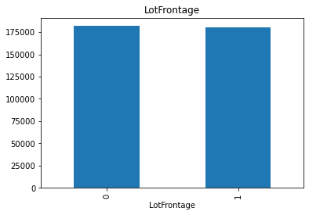
Impact of missing feature on sale price: lotfrontage

Slide 5
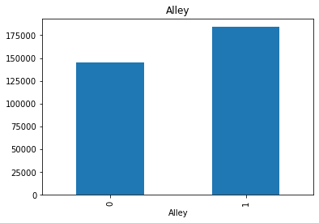
Alley

Slide 6
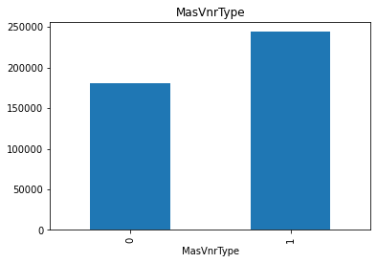
MasVnrType

Slide 7

MasVnrArea

Slide 8
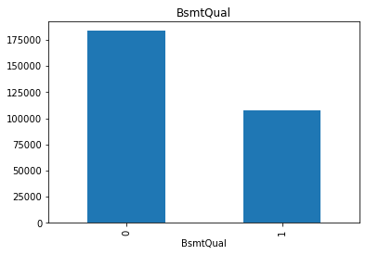
BsmtQual

Slide 9

BsmtCond

Slide 10
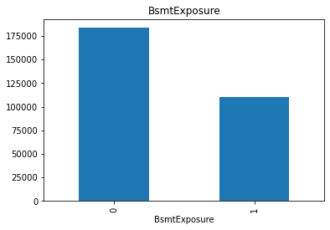
BsmtExposure

Slide 11
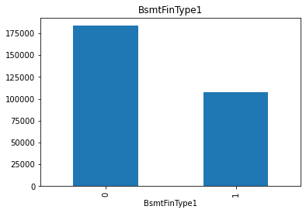
BsmtFinType1

Slide 12
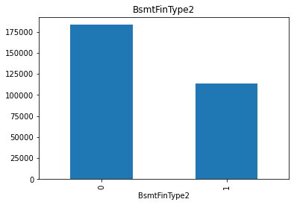
BsmtFinType2

Slide 13
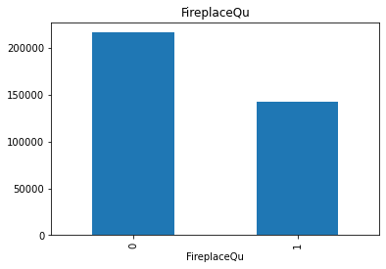
FireplaceQu

Slide 14
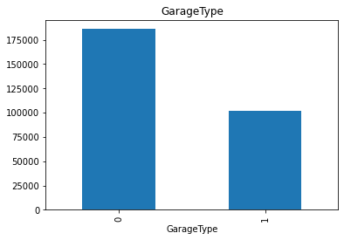
GarageType

Slide 15

GaraheYrBlt

Slide 16

GarageFinish

Slide 17

GarageQual

Slide 18

GarageCond

Slide 19
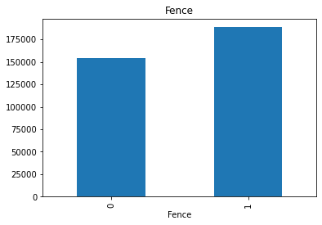
Fence

Slide 20
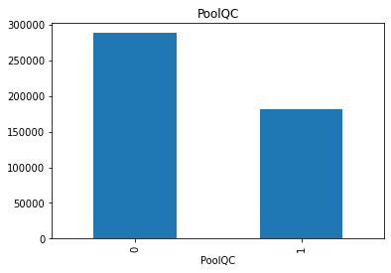
PoolQC

Slide 21
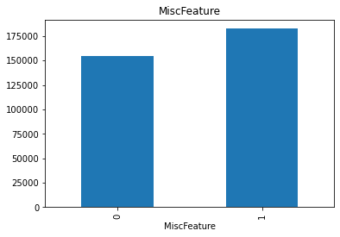
MiscFeature

Slide 22
From features create different group
Year Grp- year_features = [features for features in numerical_features if "Yr" in features or "Year" in features]
Result- ['YearBuilt', 'YearRemodAdd', 'GarageYrBlt', 'YrSold']
Discrete Grp- discrete_features = [feature for feature in numerical_features if len(df[feature].unique())<25 and feature not in year_features]

Slide 23
Cont:
Result- ['MSSubClass', 'OverallQual', 'OverallCond', 'LowQualFinSF', 'BsmtFullBath', 'BsmtHalfBath', 'FullBath', 'HalfBath', 'BedroomAbvGr', 'KitchenAbvGr', 'TotRmsAbvGrd', 'Fireplaces', 'GarageCars', '3SsnPorch', 'PoolArea', 'MiscVal', 'MoSold']
Continuous Grp- continous_features = [feature for feature in numerical_features if feature not in discrete_features+year_features+['Id']]
Result-

Slide 24
Connt:
['LotFrontage', 'LotArea', 'MasVnrArea', 'BsmtFinSF1', 'BsmtFinSF2', 'BsmtUnfSF', 'TotalBsmtSF', '1stFlrSF', '2ndFlrSF', 'GrLivArea', 'GarageArea', 'WoodDeckSF', 'OpenPorchSF', 'EnclosedPorch', 'ScreenPorch', 'SalePrice']
Category Grp- categorical_features =[feature for feature in df.columns if df[feature].dtypes == 'O']

Slide 25
Cont:
Result-['MSZoning', 'Street', 'Alley', 'LotShape', 'LandContour', 'Utilities', 'LotConfig', 'LandSlope', 'Neighborhood', 'Condition1', 'Condition2', 'BldgType', 'HouseStyle', 'RoofStyle', 'RoofMatl', 'Exterior1st', 'Exterior2nd', 'MasVnrType', 'ExterQual', 'ExterCond', 'Foundation', 'BsmtQual', 'BsmtCond', 'BsmtExposure', 'BsmtFinType1', 'BsmtFinType2', 'Heating', 'HeatingQC', 'CentralAir', 'Electrical', 'KitchenQual', 'Functional', 'FireplaceQu', 'GarageType', 'GarageFinish', 'GarageQual', 'GarageCond', 'PavedDrive', 'PoolQC', 'Fence', 'MiscFeature', 'SaleType', 'SaleCondition']

Slide 26
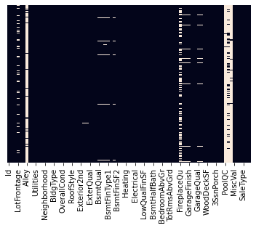
Finding Null values using heat map

Slide 27
Cleaning data
1. for feature in categorical_features:
df[feature] = df[feature].fillna(df[feature].mode())
df_test[feature] = df_test[feature].fillna(df_test[feature].mode())
2. for feature in discrete_features:
df[feature] = df[feature].fillna(df[feature].mode())
df_test[feature] = df_test[feature].fillna(df_test[feature].mode())
3. for feature in year_features:
df[feature] = df[feature].fillna(df[feature].mode())
df_test[feature] = df_test[feature].fillna(df_test[feature].mode())
4. continous_numerical_features = [feature for feature in continous_features if feature not in 'SalePrice']
5. for feature in continous_numerical_features:
df[feature] = df[feature].fillna(df[feature].mean()) #train
df_test[feature] = df_test[feature].fillna(df_test[feature].mean()) #test

Slide 28
Dropping column not need
1. for feature in more_than_50_percent_misssing_value_features:
df.drop([feature],axis = 1, inplace = True)
df_test.drop([feature],axis = 1, inplace = True)
2. df.drop(['Id'],axis = 1, inplace = True)
df_test.drop(['Id'],axis = 1, inplace = True)

Slide 29
Importing XGBOOST
!pip install xgboost
import xgboost
classifier=xgboost.XGBRegressor()
classifier.fit(X_train,y_train))
import pickle
filename = "finalazied_model.plk"
pickle.dump(classifier,open(filename,'wb'))

Slide 30
Fit MODEL
y_predict = classifier.predict(df_Test)
RESULT- array([111149.47, 110613.13, 192197.2 , ..., 147150.55, 154340.69, 99649.4 ], dtype=float32)

Slide 31
Cont:
regressor=xgboost.XGBRegressor()
booster=['gbtree','gblinear']
base_score=[0.25,0.5,0.75,1]
## Hyper Parameter Optimization
n_estimators = [100, 500, 900, 1100, 1500]
max_depth = [2, 3, 5, 10, 15]
learning_rate=[0.05,0.1,0.15,0.20]
min_child_weight=[1,2,3,4]
hyperparameter_grid = {
'n_estimators': n_estimators,
'max_depth':max_depth,
'learning_rate':learning_rate,
'min_child_weight':min_child_weight,
'booster':booster,
'base_score':base_score
}

Slide 32
Cont:
from sklearn.model_selection import RandomizedSearchCV
regressor = xgboost.XGBRegressor()
random_cv = RandomizedSearchCV(estimator=regressor,
param_distributions=hyperparameter_grid,
cv=5, n_iter=50,
scoring = 'neg_mean_absolute_error',n_jobs = 4,
verbose = 5,
return_train_score = True,
random_state=42)
random_cv.fit(X_train,y_train)

Slide 33
Cont:
regressor=xgboost.XGBRegressor(base_score=0.25, booster='gbtree', callbacks=None,
colsample_bylevel=1, colsample_bynode=1, colsample_bytree=1,
early_stopping_rounds=None, enable_categorical=False,
eval_metric=None, gamma=0, gpu_id=-1, grow_policy='depthwise',
importance_type=None, interaction_constraints='',
learning_rate=0.1, max_bin=256, max_cat_to_onehot=4,
max_delta_step=0, max_depth=2, max_leaves=0, min_child_weight=1,
monotone_constraints='()', n_estimators=900, n_jobs=0,
num_parallel_tree=1, predictor='auto', random_state=0, reg_alpha=0,
reg_lambda=1)

Slide 34
Cont:
regressor.fit(X_train,y_train)
y_predict1 = regressor.predict(df_Test)
y_predict1
Result- array([112933.76 , 115293.45 , 194892.48 , ..., 152473.6 , 145897.03 , 98077.766], dtype=float32)

